Slide 1
Determination of the Reference Range of Zinc and Copper Trace Elements in Turkish Society
Rana Sönmez
Mentor : Dr.Şahabettin Selek

Slide 2
What is clinical biochemistry ?
Clinical biochemistry is a branch of science that include the analysis of various liquids and secretions taken from the body to examine processes such as diagnosis , differential diagnosis , prevention and treatment follow-up.

Slide 3
What is the importance of zinc and copper ?
Zinc and copper trace elements are two elements that must be present at certain levels in order for many enzymes in the human body to perform their functions. Deficiency or excess in the levels of these elements can result in important diseases.

Slide 4
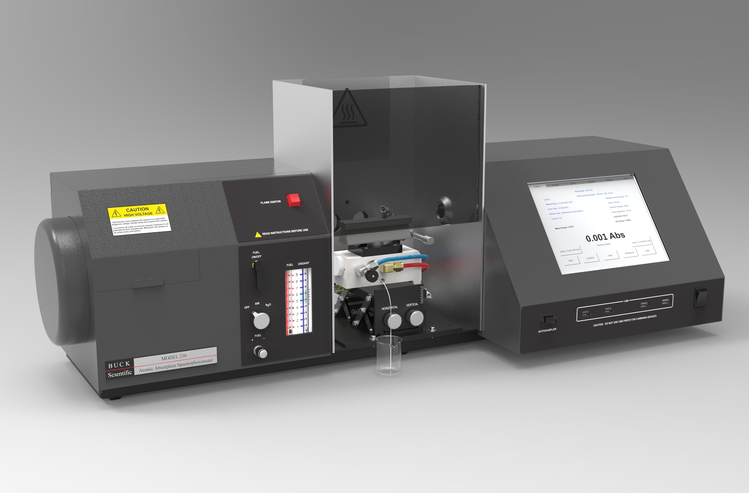
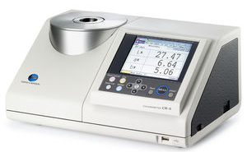
What are Zinc and Copper measuring methods ?
- Atomic Absorption Spectrometry ( ASS ) : When measuring with AAS, the elements are first gasified and when atoms are exposed to electromagnetic radiation of a certain wavelength, it creates a measurable signal. Formed The absorption signal is directly proportional to the element concentration in the samples.
- Colorometric methods : The level of the analyte is determined according to the color formed as a result of the reaction of the analyte whose level is desired to be determined with chromogen molecules.

Slide 5
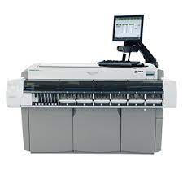
What is the diference of our method ?
1. Zinc The molecule 5-Br-PAPS (2-(5-bromo-2-pyridylazo)-5-(N-n-propyl-N-3-sulfopropylamino)phenol), which is the chelator of the trace element zinc, creates a red-violet color in the presence of zinc. This color change, which occurs in the basic environment in which the chelator is located, is measured colorimetrically at 548 nm in the spectrophotometer device calibrated with the zinc sulfate solution prepared in deionized water, and the amount of zinc in the sample is determined.
2. Copper 3,5-DiBr-PAESA (4-(3,5-Dibromo-2-pyridylazo)-N-ethyl-N-(3-sulfopropyl)aniline, monosodium salt, monohydrate) molecule, which is the chelator of copper trace element, is blue in the presence of copper. -It creates an indigo color. This color change, which occurs in the acidic environment in which the chelator is located, is measured colorimetrically at 572 nm in the spectrophotometer device calibrated with the copper sulfate solution prepared in deionized water, and the amount of copper in the sample is determined.

Slide 6
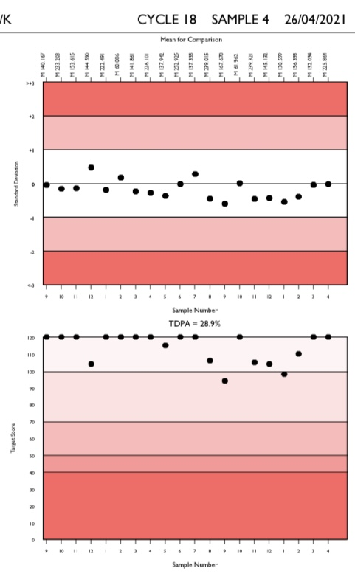
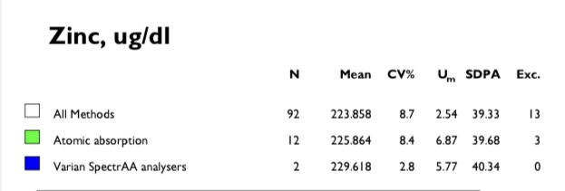
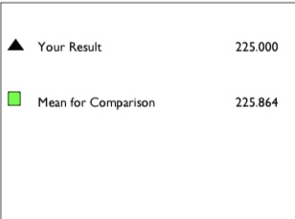

Slide 7
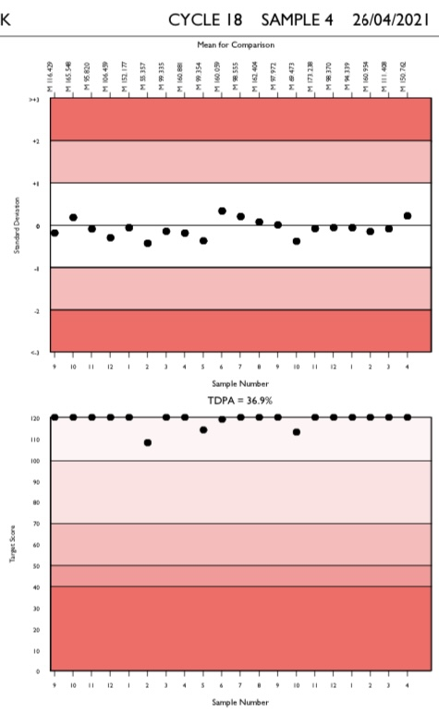

Slide 8
What is the importance of determining the reference range ?
The reference range is reported to inform clinicians requesting the test about the range of results considered disease-free by the laboratory.

Slide 9
What is the aim of this study ?
Since the reference values show variation among societies , determining the reference values of trace elements in Turkish society is of great importance in determining whether there is any disease and treatment follow-up.
In this research, we think that determining the reference range of zinc and copper using the colorometric automated zinc and copper kit developed in our university will contribute to the clinicians and the scientific world.

Slide 10
Materials and Methods :
- Identification of referance individuals :
We used direct method , in this method exclusion criteria are applied before sample collection, survey and sample collection phases are carried out simultaneously while examining potential reference individuals groups expected to be healthy.Samples collected in gel-free serum separation tubes taken from individuals who apply to the outpatients clinics of Bezmialem Vakıf University Health Application and Research Center for other reasons and whose laboratory results have not been found to have a disease included in the study after the desired tests are performed.

Slide 11
What are the exclusion criteria ?
Obesity
Pregnancy
Malignancy
Hypertension
Cardiovascular disease
Genetic disease
Drug use
Alcohol and smoking
History of tranfusion
Neurodegenerative diseases ( Wilson , Menkes , Alzehaimer’s , Parkinson and Hungtington )

Slide 12
What is ideal number of individuals to determine the reference range ?
- General criteria for number determination 95% reference interval , 90% confidence interval , at least 120 assuming that no results are derived from the reference set.
If there is a need for separate intervals for different subclasses (eg by gender or age), the recommended number for each group is at least 120.
It can be difficult to collect the recommended number of reference samples in neonatal, pediatric, and geriatric patient groups. Regardless of the number, the data should be analyzed according to the non-parametric method.
Therefore , the reference range of at least 120 male and 120 female healthy volunteers between the ages of 16 and 60 who applied to Bezmialem Vakıf University Health Application and Research Center it was determined that would be sufficient.

Slide 13
Parametric vs Non-parametric Methods :
Parametric Method :
2.5 percent = Mean – 1.96 x SD
97.5 percent = Mean + 1.96 x SD
SD: Standart deviation
The results in this method directly indicate the lower and upper reference limit.
Non-Parametric method :
Low value = 0.025 x (n+1)
High value = 0.975 x (n+1)
N: number of samples
The results are sorted from largest to smallest. The results in the order of the values ​​obtained here are determined as the reference limit.

Slide 14
Analysis of the referance range :
– Outlier
Dixon → the ratio D/R, where D is the absolute difference between an extreme observation (large or small) and the next largest (or smallest) observation, and R is the range of all observations, including extremes.
Reed et al. → if the difference D is equal to or greater than1/3 of the range R, the extreme observation is deleted.
Working group supports the use of this test in examining a set of observed reference values for statistically significant outliers.
Another method of outlier detection → Tukey → uses only the middle 50% of the sample, thus reducing, or even eliminating, the possible masking effect of multiple outliers on one side of the distribution.

Slide 15
Results :
As the result of the power analysis , it was found that at least 120 male and 120 female healthy volunteers between the ages of 16 and 60 who applied to the BVU-HARC from the Turkish community would be sufficient in determining the reference range.
We used automated colorimetric zinc and copper kit that produced by our university to measure zinc and copper levels in appropriate samples.

Slide 16
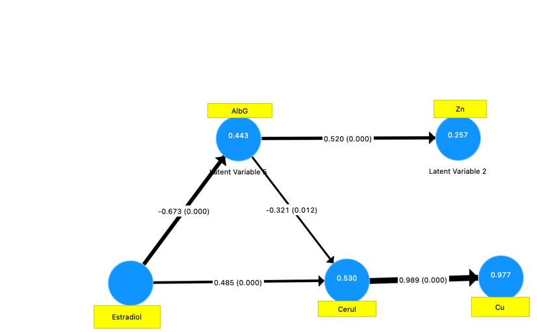

Slide 17
Descriptives | Copper (ug/dL) | Zinc (ug/dL)
 | Male (n=120) Female (n=120) | Male (n=120) Female (n=120)
Mean | 105.59 118.89 | 97.09 102.32
Standart Deviation | 17.84 18.88 | 8.72 9.03
Reference Interval | Copper (ug/dL) | Zinc (ug/dL)
 | Low High | Low High
Male | 70 (67-73) 140 (137-143) | 80 (78-81) 120 (119-121)
Female | 80 (78-84) 155 (152-158) | 80 (78-81) 120 (119-121)

Slide 18
Conclusion :
- It is very impotante to determine a separate reference range for pregnant women.
- While looking at copper and zinc levels, estrogen and albumin levels should also be measured.
- The reference range we found is parallel to the literature, which indicates that the kit we used in our university is healthy and useable.

Slide 19
References :
1. Astrup, P., Clinical chemistry--a changing discipline. Clin Chem, 1975. 21(12): p. 1709-15.
2. Rohr, U.P., et al., The Value of In Vitro Diagnostic Testing in Medical Practice: A Status Report. PLoS One, 2016. 11(3): p. e0149856.
3. Melo, A., et al., Oxidative stress in neurodegenerative diseases: mechanisms and therapeutic perspectives. Oxid Med Cell Longev, 2011. 2011: p. 467180.
4. Theodorsson, E. and B. Magnusson, Full method validation in clinical chemistry. Accreditation and Quality Assurance, 2017. 22: p. 235-246.
5. Tapiero, H. and K.D. Tew, Trace elements in human physiology and pathology: zinc and metallothioneins. Biomed Pharmacother, 2003. 57(9): p. 399-411.
6. Tapiero, H., D.M. Townsend, and K.D. Tew, Trace elements in human physiology and pathology. Copper. Biomed Pharmacother, 2003. 57(9): p. 386-98.
7. Mellon, M.G., The Role of Spectrophotometry in Colorimetry. Industrial & Engineering Chemistry Analytical Edition, 1937. 9(2): p. 51-56.
8. Koktasoglu, F., et al., New zinc assay for automated clinical chemistry analyzers. Clinica Chimica Acta, 2019. 493: p. S624-S625.
.

Slide 20
9. Caglar, H.G., et al., New copper assay for automated clinical chemistry analyzers. Clinica Chimica Acta, 2019. 493: p. S632.
10. Miller, W.G., et al., Reference intervals: strengths, weaknesses, and challenges. Clinical Chemistry, 2016. 62: p. 916+.
11. Ozarda, Y., Reference intervals: current status, recent developments and future considerations. Biochemia medica, 2016. 26(1): p. 5-16.
12. Solberg, H.E., Using a hospitalized population to establish reference intervals: pros and cons. Clin Chem, 1994. 40(12): p. 2205-6.
13. Ritchie, R.F. and G. Palomaki, Selecting clinically relevant populations for reference intervals. Clin Chem Lab Med, 2004. 42(7): p. 702-9.
14. Horn, P.S., A.J. Pesce, and B.E. Copeland, A robust approach to reference interval estimation and evaluation. Clin Chem, 1998. 44(3): p. 622-31.
15. Sikaris, K.A., Physiology and its importance for reference intervals. The Clinical biochemist. Reviews, 2014. 35(1): p. 3-14.
16. Kroll, M.H., et al., Evaluation of the extent of nonlinearity in reportable range studies. Arch Pathol Lab Med, 2000. 124(9): p. 1331-8.

